Slide 1
SMS SPAM MESSAGE DETECTION USING “MACHINE LEARNING AND DEEP LEARNING TECHNIQUES”
Ashwani Attri
BACHU RAM CHARAN 22AG1A6772
HARINI
23AG5A6707
VUDGULA SAI PRABHAS 22AG1A67C5

Slide 2
CONTENTS
ABSTRACT
INTRODUCTION
EXISTING SYSTEM & DRAWBACKS
LITERATURE SURVEY
PROPOSED MODEL / SYSTEM
Software Requirements & Hardware Requirements
Functional Requirements & Non-Functional Requirements
Data Collection
Module Description
System Architecture
UML Diagrams

Slide 3
Abstract
The number of people using mobile devices increasing day by day. SMS (short message service) is a text message service available in smartphones as well as basic phones. So, the traffic of SMS increased drastically. The spam messages also increased. The hackers try to send spam messages for their financial or business benefits like market growth, lottery ticket information, credit card information, etc. So, spam classification has special attention. In this paper, we applied various machine learning and deep learning techniques for SMS spam detection. we used a dataset to train the machine learning and deep learning models like LSTM and NB. The SMS spam collection data set is used for testing the method. The dataset is split into two categories for training and testing the research. Our experimental results have shown that our NB model outperforms previous models in spam detection with an accuracy of good.

Slide 4

Introduction
This presentation explores the use of machine learning and deep learning techniques for detecting SMS spam messages. It provides an overview of the existing systems, identifies their limitations, and outlines a proposed model to enhance SMS spam detection accuracy and efficiency.

Slide 5
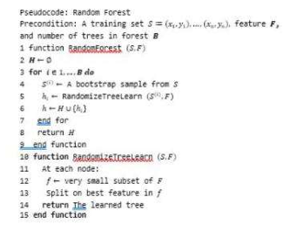
EXISTING SYSTEM
Random Forest (RF) algorithm will used for classification of ham or spam during this phase. RF is averaging ensemble learning method that can be used for classification problem. This algorithm combines various decision tree models in order to eliminate the over fitting problem in decision trees. In RF algorithm, each tree is capable in providing its own prediction results, different from each other. As a result, each tree gives different performances, in which the average of their performances will be generalized and calculated. During the training phase, a set of decision trees will be constructed before they can operate on randomly selected features. Regardless, RF can work well with a large dataset with a variety of feature types, similar to binary, categorical and numerical.
EXISTING TECHINIQUE: KNN and Random forest.

Slide 6
Existing System Drawbacks
Limited Accuracy
Lack of Adaptability
Computational Complexity
User Privacy Concerns
Existing SMS spam detection systems often struggle to accurately identify all instances of spam, leading to a high rate of false positives or negatives.
Traditional rule-based systems are unable to adapt to evolving spam techniques, making them less effective over time.
Some existing approaches require significant computational resources, making them impractical for real-time SMS processing.
Many existing solutions require access to the full message content, raising privacy concerns for users.

Slide 7



Literature Survey
Academic Studies
Existing Techniques
Real-World Applications
Several academic studies have explored the use of machine learning and deep learning techniques for detecting SMS spam messages. These studies have analyzed large datasets and developed effective classification models.
Researchers have investigated a variety of machine learning and deep learning approaches, including support vector machines, naïve Bayes classifiers, and recurrent neural networks, to address the SMS spam detection problem.
Industry solutions have also been developed to tackle SMS spam, leveraging techniques such as rule-based filtering, content analysis, and behavioral patterns to identify and block unwanted messages.

Slide 8
TITLE: SMS Spam Detection Based on Long Short-Term Memory and Gated Recurrent Unit
Author: Pumrapee Poomka, Wattana Pongsena, Nittaya Kerdprasop, and Kittisak Kerdprasop
YEAR: - 2019
Short-Term Memory technique provides the best overall accuracy as high as 98.18%. On accurately screening spam messages, this model shows the ability that it can detect spam messages with the 90.96% accuracy rate, while the error percentage that it misclassifies a normal message as a spam message is only 0.74%.
TITLE: SMS Spam Message Detection using Term Frequency-Inverse Document Frequency and Random Forest Algorithm
Author: Haslina Md Sarkan, Yazriwati Yahya, Suriani Mohd Sam
YEAR: - 2019
Random Forest Algorithm will be applied on SMS spam message data collection. Based on the experiment, Random Forest algorithm outperforms other algorithms with an accuracy of 97.50%

Slide 9

Proposed Model / System
The proposed system leverages a combination of machine learning and deep learning techniques to detect SMS spam messages. The model architecture includes an input layer, several hidden layers for feature extraction and classification, and an output layer that predicts whether a message is spam or ham.
Key components of the system include a preprocessing module, a feature engineering module, and the deep learning model itself. The preprocessing step cleans and normalizes the SMS text data, while the feature engineering module extracts relevant linguistic and behavioral features.

Slide 10
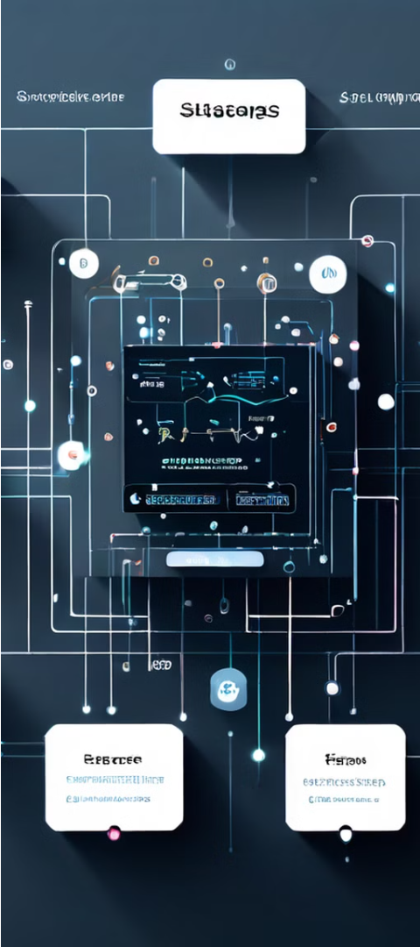
System Analysis
1
Understand Requirements
Analyze the client's needs and objectives for the SMS spam detection system. Identify key functionalities, performance targets, and user expectations.
2
Evaluate Existing Solutions
Research and assess current SMS spam detection techniques, both machine learning and deep learning-based. Identify strengths, weaknesses, and areas for improvement.
3
Design System Architecture
Propose a scalable and modular system architecture that integrates the chosen machine learning and deep learning algorithms. Ensure the system is efficient, maintainable, and adaptable to future requirements.

Slide 11



Software and Hardware Requirements
Hardware
Software
Data Storage
The system requires a modern computer with a decent processor, memory, and storage capacity to handle the computational demands of the machine learning models.
The system will utilize popular machine learning and deep learning libraries like TensorFlow, Keras, or PyTorch, along with supporting tools for data preprocessing, model training, and evaluation.
A robust database system, such as MongoDB or PostgreSQL, will be required to store the SMS message dataset used for training and testing the models.

Slide 12
Hardware and Software requirements
HARDWARE REQUIREMENTS: The hardware requirements may serve as the basis for a contract for the implementation of the system and should therefore be a complete and consistent specification of the whole system. They are used by software engineers as the starting point for the system design. It shows what the system does and not how it should be implemented
PROCESSOR : Intel I5
RAM : 4GB
HARD DISK : 40 GB
SOFTWARE REQUIREMENTS: The software requirements document is the specification of the system. It should include both a definition and a specification of requirements.
PYTHON IDE : Anaconda Jupyter Notebook
PROGRAMMING LANGUAGE : Python

Slide 13
Functional Requirements
1. Data Collection and Preprocessing
Collect Data: Gather SMS messages from various sources.
Clean Data: Remove unwanted characters and duplicate messages.
Label Data: Mark messages as spam or not spam.
Split Data: Divide data into training, validation, and testing sets.
2. Feature Engineering
Process Text: Break down messages into words, remove common words, and reduce words to their root form.
Extract Features: Convert text into numerical data using methods like Bag of Words, TF-IDF, or embeddings.
3. Model Development
Choose Models: Use traditional ML models (like Naive Bayes or SVM) or DL models (like RNNs or Transformers).
Train Models: Use the data to train these models.
Evaluate Models: Measure model performance using metrics like accuracy and F1-score.

Slide 14
Non-Functional Requirements
1. Performance
Speed: The system should process messages quickly.
Scalability: The system should handle increasing numbers of messages without slowing down.
2. Reliability
Uptime: The system should be available and operational most of the time.
Accuracy: The system should consistently provide accurate spam predictions.
3. Usability
User-Friendly: The interface should be easy to use for non-technical users.
Accessibility: The system should be accessible from various devices (e.g., mobile, desktop).
4. Maintainability
Ease of Update: The system should be easy to update with new models and data.
Modularity: The system components should be designed so they can be easily modified or replaced.

Slide 15
Data Collection
The public dataset of SMS labelled messages is obtained from UCI Machine Learning Repository. The dataset considered in the current research is available on kaggle, a machine learning repository. This study finds that there are only 5,574 labelled messages in the dataset, with 4827 of messages belong to ham messages while the other 747 messages belong to spam messages. Nonetheless, this dataset consists of two named columns starting with the message labels (ham or spam) followed by strings of text messages and three unnamed columns. It‘s time for a data analyst to pick up the baton and lead the way to machine learning implementation. The job of a data analyst is to find ways and sources of collecting relevant and comprehensive data, interpreting it, and analyzing results with the help of statistical techniques.
The type of data depends on what you want to predict.
There is no exact answer to the question “How much data is needed?” because each machine learning problem is unique. In turn, the number of attributes data scientists will use when building a predictive model depends on the attributes’ predictive value.
‘The more, the better ‘approach is reasonable for this phase. Some data scientists suggest considering that less than one-third of collected data may be useful. It’s difficult to estimate which part of the data will provide the most accurate results until the model training begins. That’s why it’s important to collect and store all data — internal and open, structured and unstructured.
The purpose of preprocessing is to convert raw data into a form that fits machine learning. Structured and clean data allows a data scientist to get more precise results from an applied machine learning model. The technique includes data formatting, cleaning, and sampling.

Slide 16
Module Description
Data Collection and Preprocessing:
The Data Collection and Preprocessing module gathers SMS data from various sources, cleans and normalizes it by removing duplicates and irrelevant characters, and labels messages as spam or not spam. This prepared data is then divided into training, validation, and testing sets. The Feature Engineering module processes the text by breaking it into tokens, removing stop words, and applying stemming and lemmatization. It converts the text into numerical features using techniques like Bag of Words, TF-IDF, or embeddings such as Word2Vec and BERT.
Security and Privacy
Security and privacy are paramount, with the Security and Privacy module ensuring that user data is protected and handled in compliance with regulations like GDPR. This module also includes mechanisms to safeguard the system from unauthorized access. Comprehensive Documentation and Support are provided, detailing setup instructions, API usage, and offering channels for user support.

Slide 17
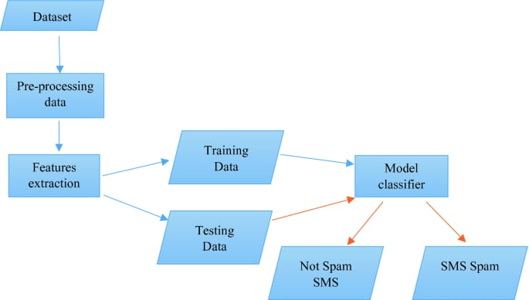
System Architecture

Slide 18
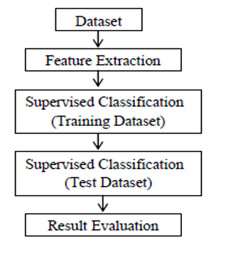
UML Diagrams
DATA FLOW DIAGRAM:
Data flow diagrams are used to graphically represent the flow of data in a business information system. DFD describes the processes that are involved in a system to transfer data from the input to the file storage and reports generation. Data flow diagrams can be divided into logical and physical. The logical data flow diagram describes flow of data through a system to perform certain functionality of a business. The physical data flow diagram describes the implementation of the logical data flow
Data Flow Diagram

Slide 19
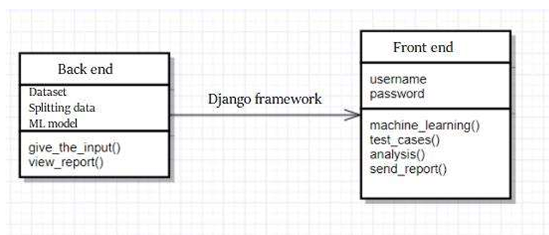
CLASS DIAGRAM:
The class diagram is a static diagram. It represents the static view of an application. Class diagram is not only used for visualizing, describing and documenting different aspects of a system but also for constructing executable code of the software application
Class Diagram

Slide 20
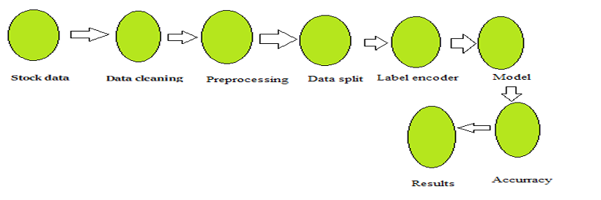
STATE FLOW DIAGRAM:
The below state chart diagram describes the flow of control from one state to another state (event) in the flow of the events from the creation of an object to its termination.
State Flow Diagram

Slide 21
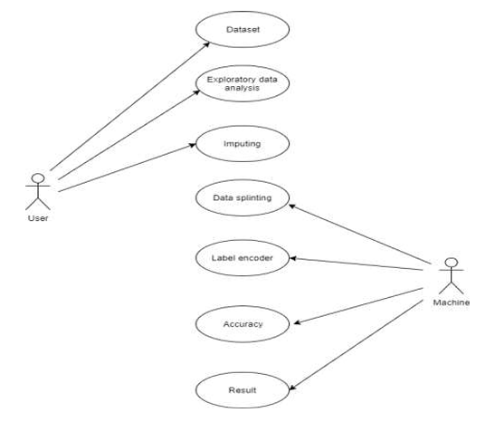
USECASE DIAGRAM:
Use case diagrams identify the functionalities provides by the use cases, the actors who interact with the system and the association between the actors and the functionalities.
Usecase Diagram

Slide 22
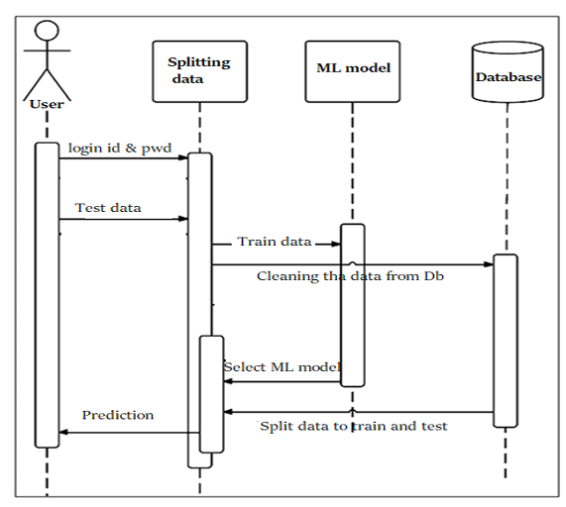
SEQUENCE DIAGRAM:
The sequence diagram of a system shows the entity interplay are ordered in the time order level. So, that it drafts the classes and object that are imply in the that plot and also the series of message exchange take place betwixt the body that need to be carried out by the purpose of that scenario. 3
Sequence Diagram

Slide 23
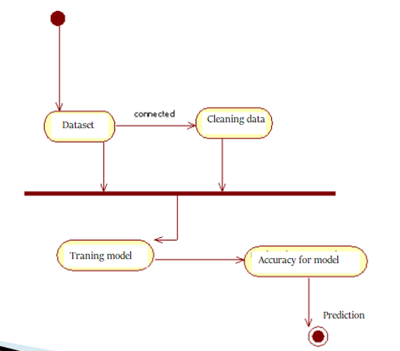
ACTIVITY DIAGRAM:
The Activity Diagram forms effective while modeling the functionality of the system. Hence this diagram reflects the activities, the types of flows between these activities and finally the response of objects to these activities.
Activity Diagram

Slide 24
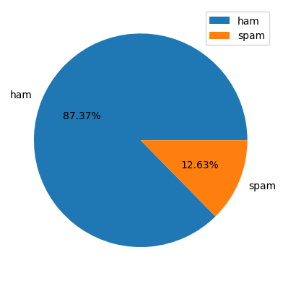
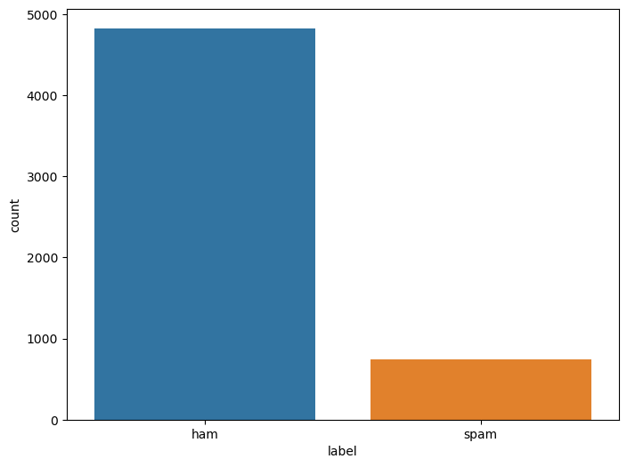
RESULT

Slide 25
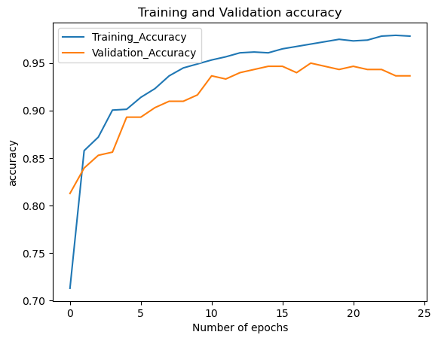
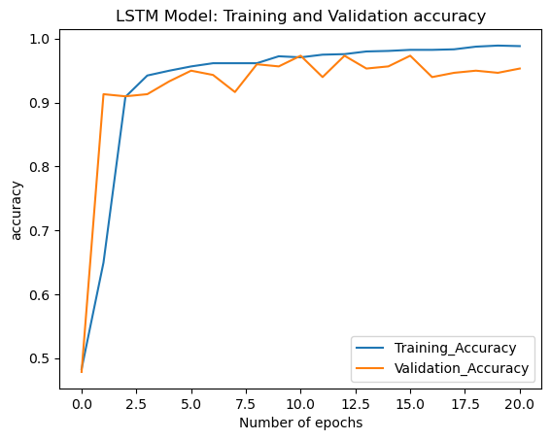

Slide 26
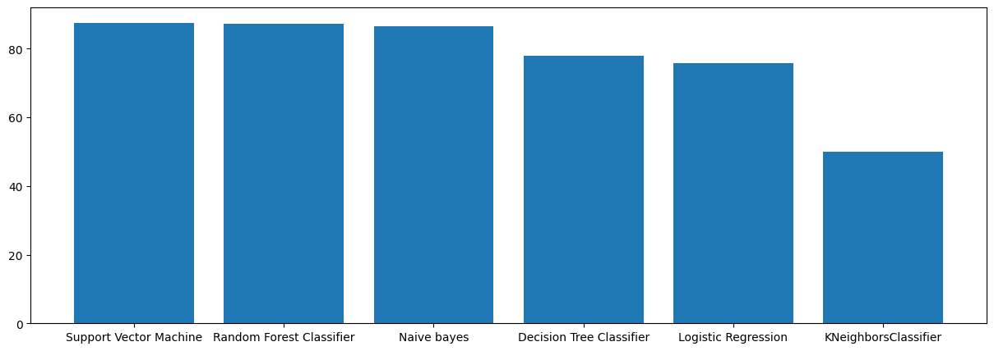

Slide 27
Methodology
1
Data Collection
Gather labeled SMS messages, both spam and non-spam, from various sources.
Data Preprocessing
2
Clean and preprocess the data, including text normalization, stop word removal, and feature extraction.
Model Training
3
Train machine learning and deep learning models using the preprocessed data, such as Naive Bayes, SVM, and Recurrent Neural Networks.
Model Evaluation
4
Evaluate the performance of the trained models using appropriate metrics like accuracy, precision, recall, and F1-score.
The methodology for this SMS spam detection system involves a comprehensive approach, starting with the collection of labeled data, followed by data preprocessing and feature engineering. The next step is to train various machine learning and deep learning models, and then evaluate their performance to select the most suitable model for the task.

Slide 28
THANK YOU

